Slide 1
z/OS DevOps End-to-End Demo
Nelson Lopez
Z DevOps Transformation Specialist
Nelson.lopez1@ibm.com

Slide 2
Session Objectives
Concepts
DevOps on Z – Really?
Continuous Integration / Continuous Deployment (CI/CD)
Git for Z
IBM’s Dependency Based Build Tool (DBB)
Urban Code Deploy for Z
Demo A Basic End-to-End workflow
Getting Started

Slide 3
Z DevOps Really?
Yes!
The tools and support are there.

Slide 4
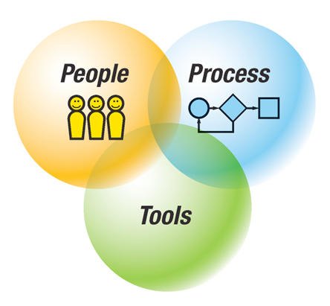








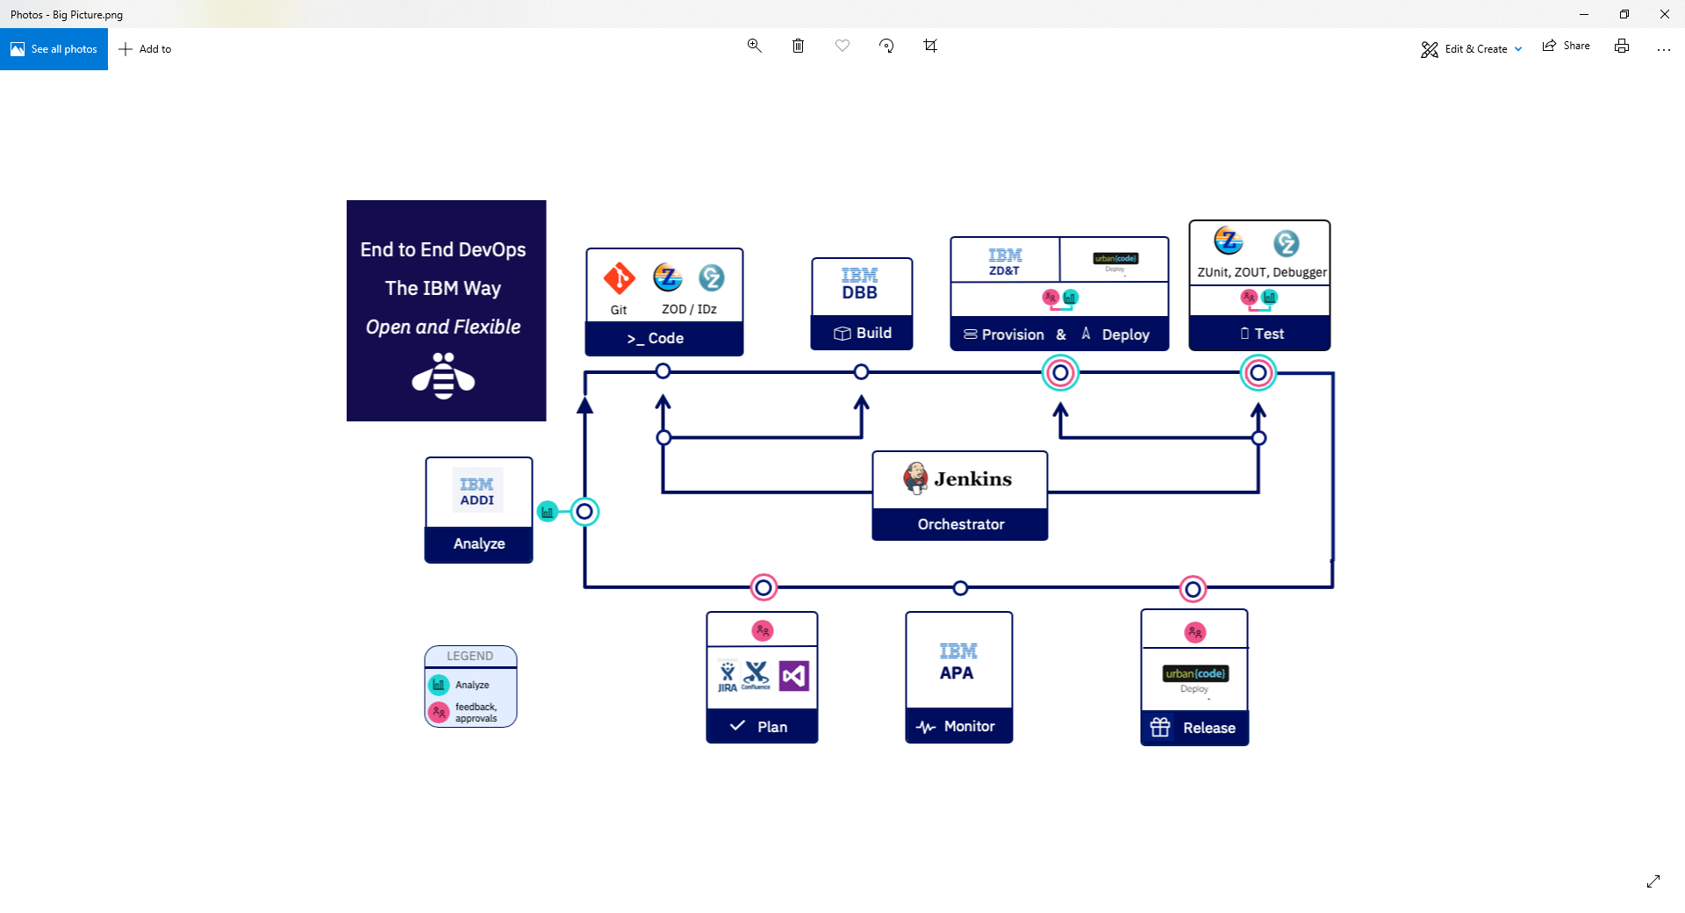
IBM Z DevOps → The Value Proposition is Strong
ENTERPRISE WIDE STANDARDIZATION
AUTOMATION
Platform neutral, continuous integration and deployment pipeline across the enterprise. Uniform enterprise wide agile delivery processes and standards facilitates transferable skills
Powerful and automated unit testing as part of a continuous delivery pipeline
50-90% time savings on test cycles²
MODERN DEVELOPMENT PRACTICES
SKILLS AVAILABILITY
Advanced Application Intelligence, Modern development IDEs to empower the next generation of developers.
20-50% productivity benefits for typical development tasks¹
#2 on Glassdoor’s 50 best Jobs in America Rankings and one of the Top 5 Technical Skills Growth areas
OPEN TOOL CHAIN
Notes:
1.Source – Validated customer feedback
2. Source - https://dzone.com/articles/the-roi-of-automated-testing
3.Accelerate State of DevOps Report 2018
4. GitLab 2018 Global Developer Report. (n.d.). Retrieved from https://about.gitlab.com/developer-survey/2018/
5. https://www.ibm.com/account/reg/us-en/signup?formid=urx-17749
6. https://www-01.ibm.com/common/ssi/cgi-bin/ssialias?htmlfid=65014265USEN&
Combining Agile and DevOps practices can make it easier to build open and hybrid applications. DevOps is the union of People, Process, and Tools to enable continuous integration and continuous delivery to our clients
People – we need to ensure that everybody delivering value to the business is working tightly together on the common goal of adding value for the customer.
Process- DevOps is about improving processes because even if you have highly motivated people that are working well together, you may still have several business processes which may get in the way, and this could really block innovation.
Tools – There are products, tools, and services that can help enable different DevOps practices and different teams which can be used to make things easier.
But even with the best tools, DevOps is just another buzzword if you don’t have the right culture.
The primary characteristic of DevOps culture is increased collaboration between the roles of development and operations. There are some important cultural shifts, within teams and at an organizational level, that support this collaboration
It IS possible and you CAN transform your zOS environment to a true, modern DevOps practice. There is nothing about Z that stops you from doing DevOps. We can bridge the gap between mainframe and distributed by bringing modern SCMs, modern parallel development and by letting developers work in mainframe and distributed worlds in the same way.
IBM’s end to end cross-platform delivery pipeline solution integrates with a variety of open source and third party tools allowing you to balance between open source and enterprise tooling to choose a pipeline that is right for your organization based on business needs.
Some of the open source and third party integrations that we offer are listed at the bottom of the slide – including GIT, Jira, Jenkins, SonarQube to name a few.
We want to focus on a common tooling across the development process. And outside of mainframe development, Git has become the defacto standard for source control in application development.
IBM Z Open Development is an ecosystem of capabilities that enables developers to get the most out of a modern SCM like Git and standardizing on true parallel development across the enterprise. ZOD helps you to work with mainframe application source that is stored in Git. It also include Dependency Based Build – which allows you to have a build took kit which you can use to build your applications and analyze the dependences required for build. DBB also includes Groovy for automation so it actually helps you to bring your mainframe processes into the world of open source so you can hook up your mainframe processes to CI/DC to open source tools like Jenkins. In a nutshell, ZOD is a full set of capabilities that allow you to accelerate devops.
Other common tooling to embrace DevOps include Jenkins to manage CI and CD workflows and this can be the same Jenkins master that is running your distributed workloads.
There is UrbanCode for deployment – again this can be the same Urban code that is used to deploy your distributed code into cloud environments and on prem environments
When we talk about deploying more changes faster, we need true parallel development that empowers the developer with autonomy for development and testing.
Automation
Continuous testing is a key part of DevOps and it means testing earlier in the life cycle, which results in reduced costs, shortened testing cycles, and continuous feedback on quality. This process of shift-left testing, stresses integrating development and testing activities to ensure quality is built-in as early in the life cycle as possible.
It’s important that the first step of the testing is done in a clean and automated way so you’re feeding in tested code into the rest of the lifecycle. And that’s why we’re investing in Unit Testing. Z Open Unit Test will be an advanced and flexible tool for writing and executing automated unit tests of programs on IBM Z.
Using ADDI, you can identify most essential test cases, redundant test cases and understand code coverage. So you use ADDI to determine what data sets need to be provisioned and can then use
(zD&T) for rapid provisioning. With zD&T, you have the ability to rapidly spin up and take down z/OS test environments on demand both on premise and in the cloud. It empowers development teams with autonomy to have their own test environment… which means you avoid issues of contending for resources or even contenting for capacity.
So When you combine the automated unit testing capabilities of Z Open Unit Test, application understanding capabilities of ADDI to facilitate targeted provisioning with zD&T, it becomes a game changer and can truly differentiate you when you’re striving for more agility with testing on the mainframe.
Another driving factor for common tools across the stack is that we need to attract the younger generations to this environment, we need to bring the current development practices to this environment. And we can do that by looking at the distributed pipeline and bring it to the Z platform. This allows for cross training developers on familiar tooling so they don’t need to learn mainframe specific tools.
Z is the most reliable platform you have in your organization – it’s the most modern platform you have in your organization – we need to take that platform and use it to its best value.
Industry leading security, speed and scale
When it comes to building our Hybrid applications, the right platform is essential for fast, secure and scalable transactions. IBM Hyper Protect Services brings continuous security and scalability so all data is encrypted in use, in flight and at rest. Blockchain in Z gives you 8.5xmore effective secutiy than x86 and lets you deploy new apps 3x faster. IBM Blockchain Platform is now available to deploy on multi-cloud, including on-prem using IBM Cloud Private on Z.

Slide 5
Notes:
What we want to do is provide this pipeline as the automation framework for the DevOps transformation

Slide 6
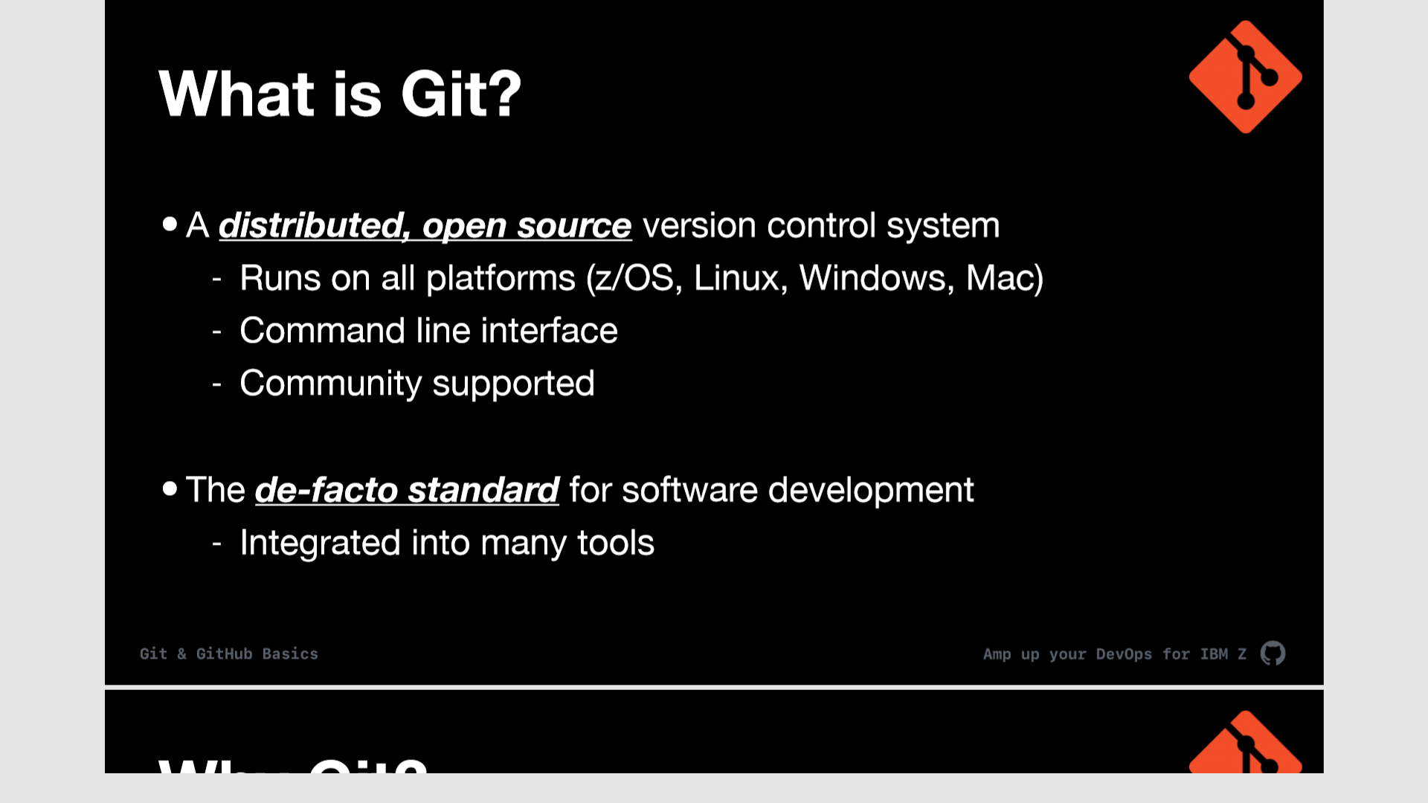


Slide 7
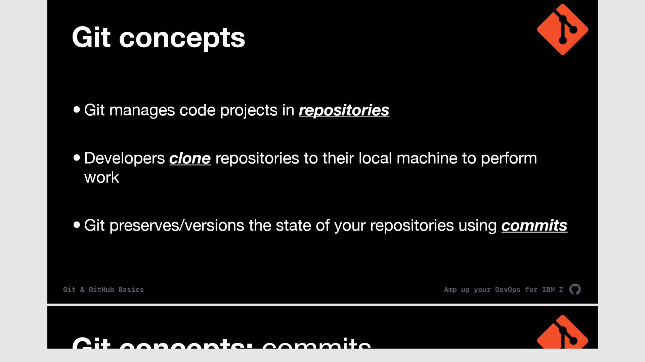
Git manages code projects in repositories
Developers clone repo(s) to their local PC to work
Git preserves/versions the state of a repo using commits
A branch allows developers to work in isolation

Slide 8
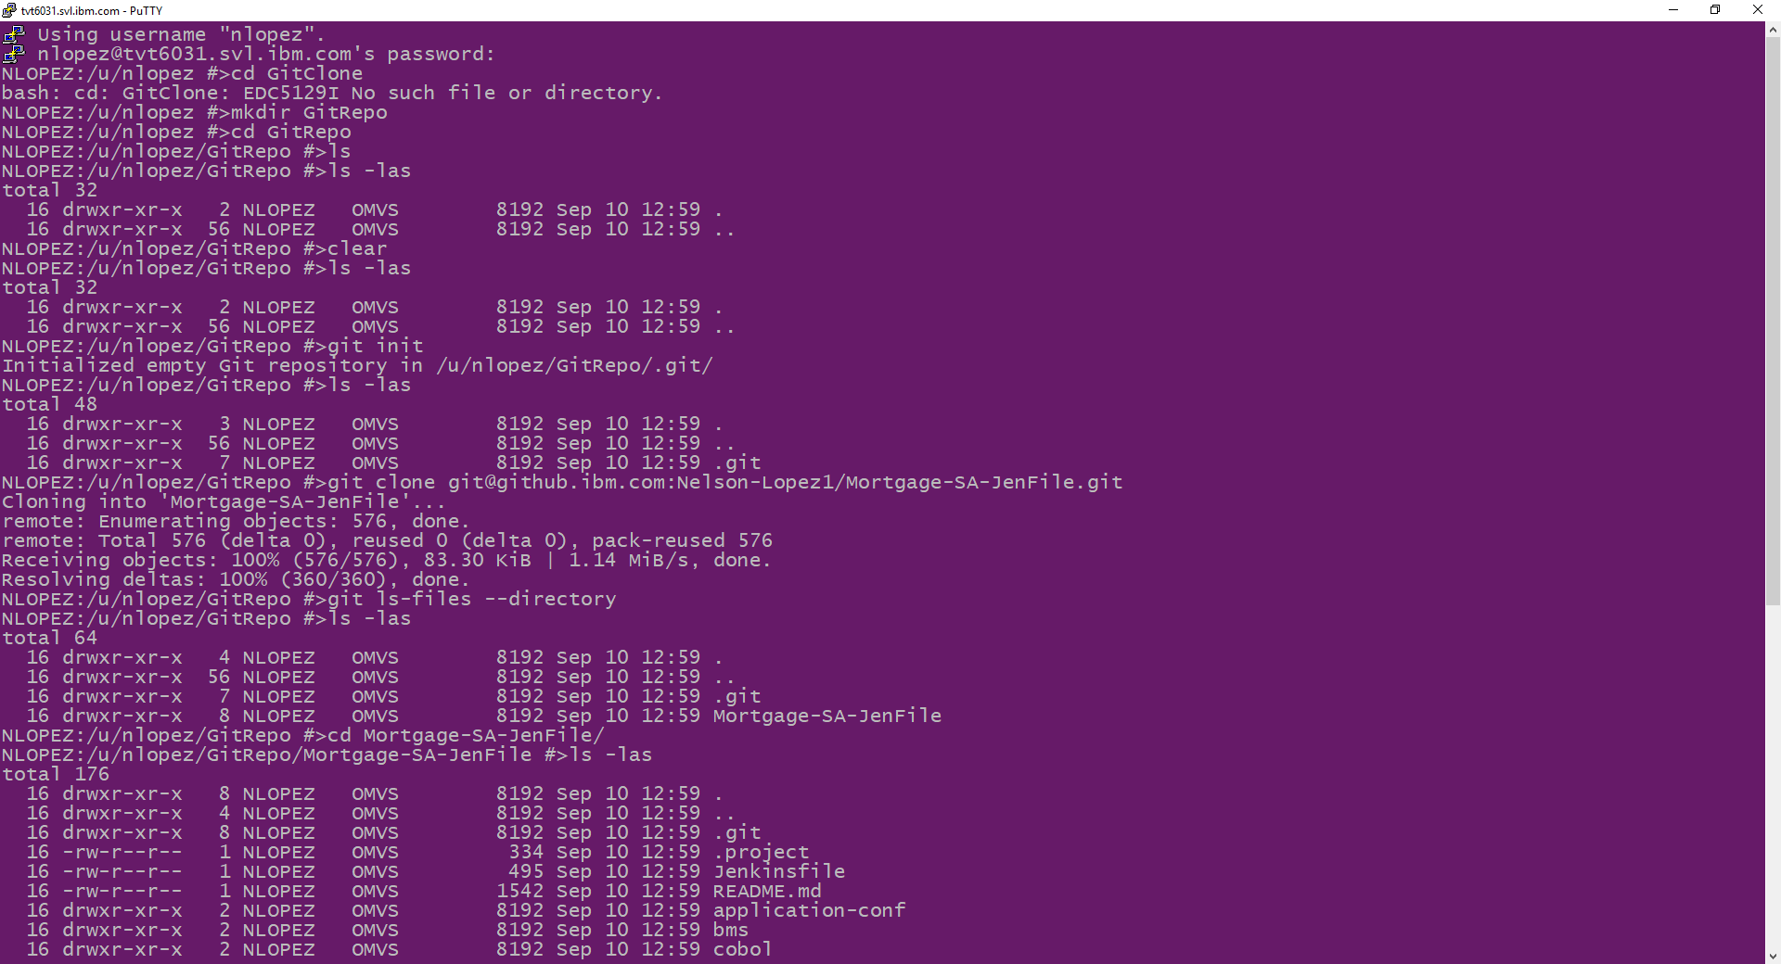
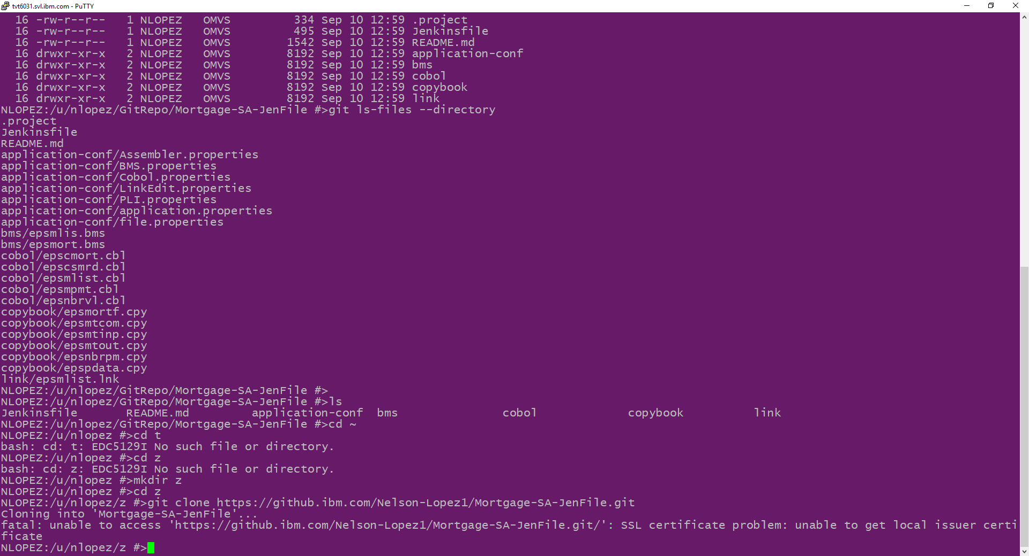
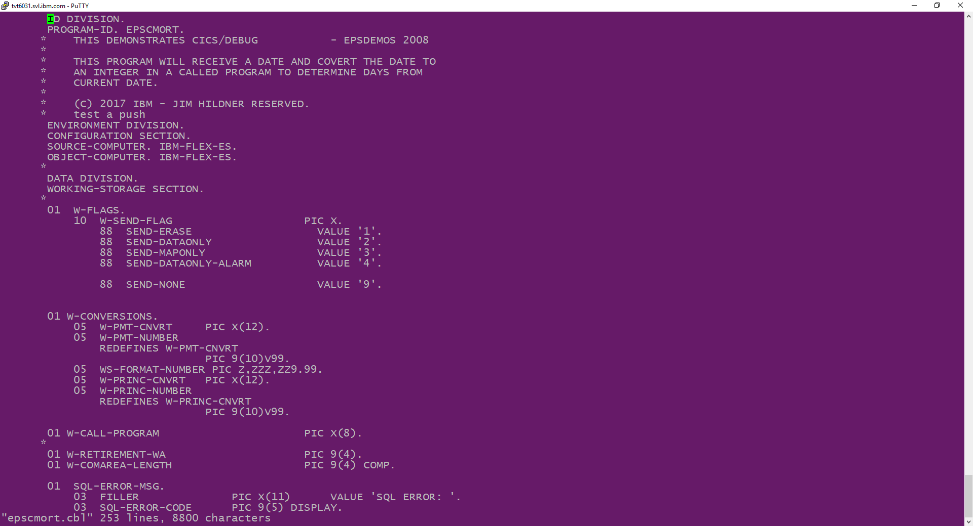
Clone a COBOL repo on Z
git clone your-repo=url

Slide 9
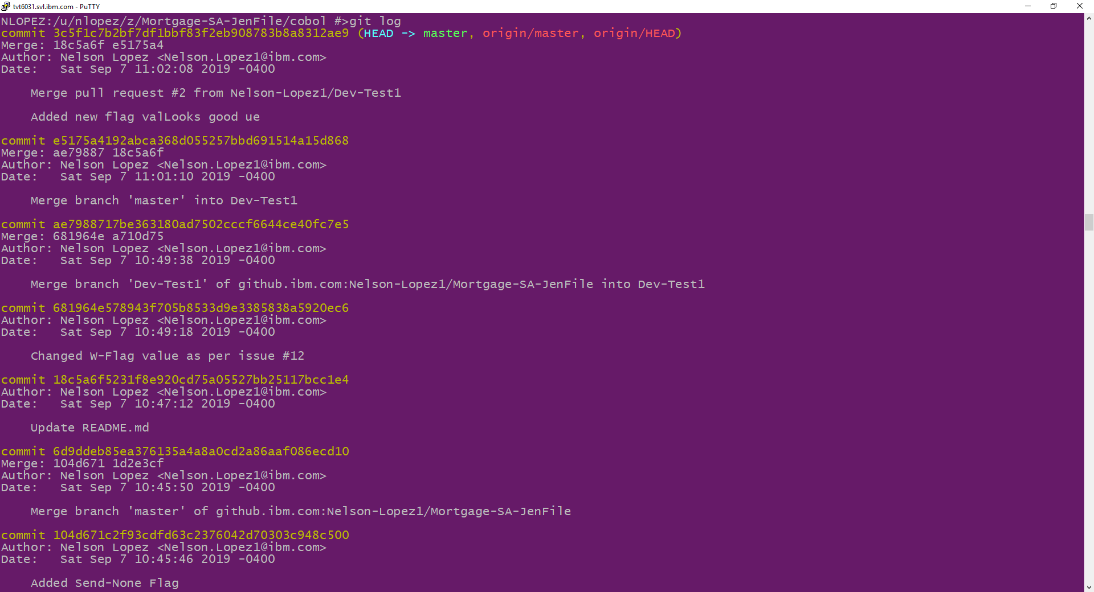
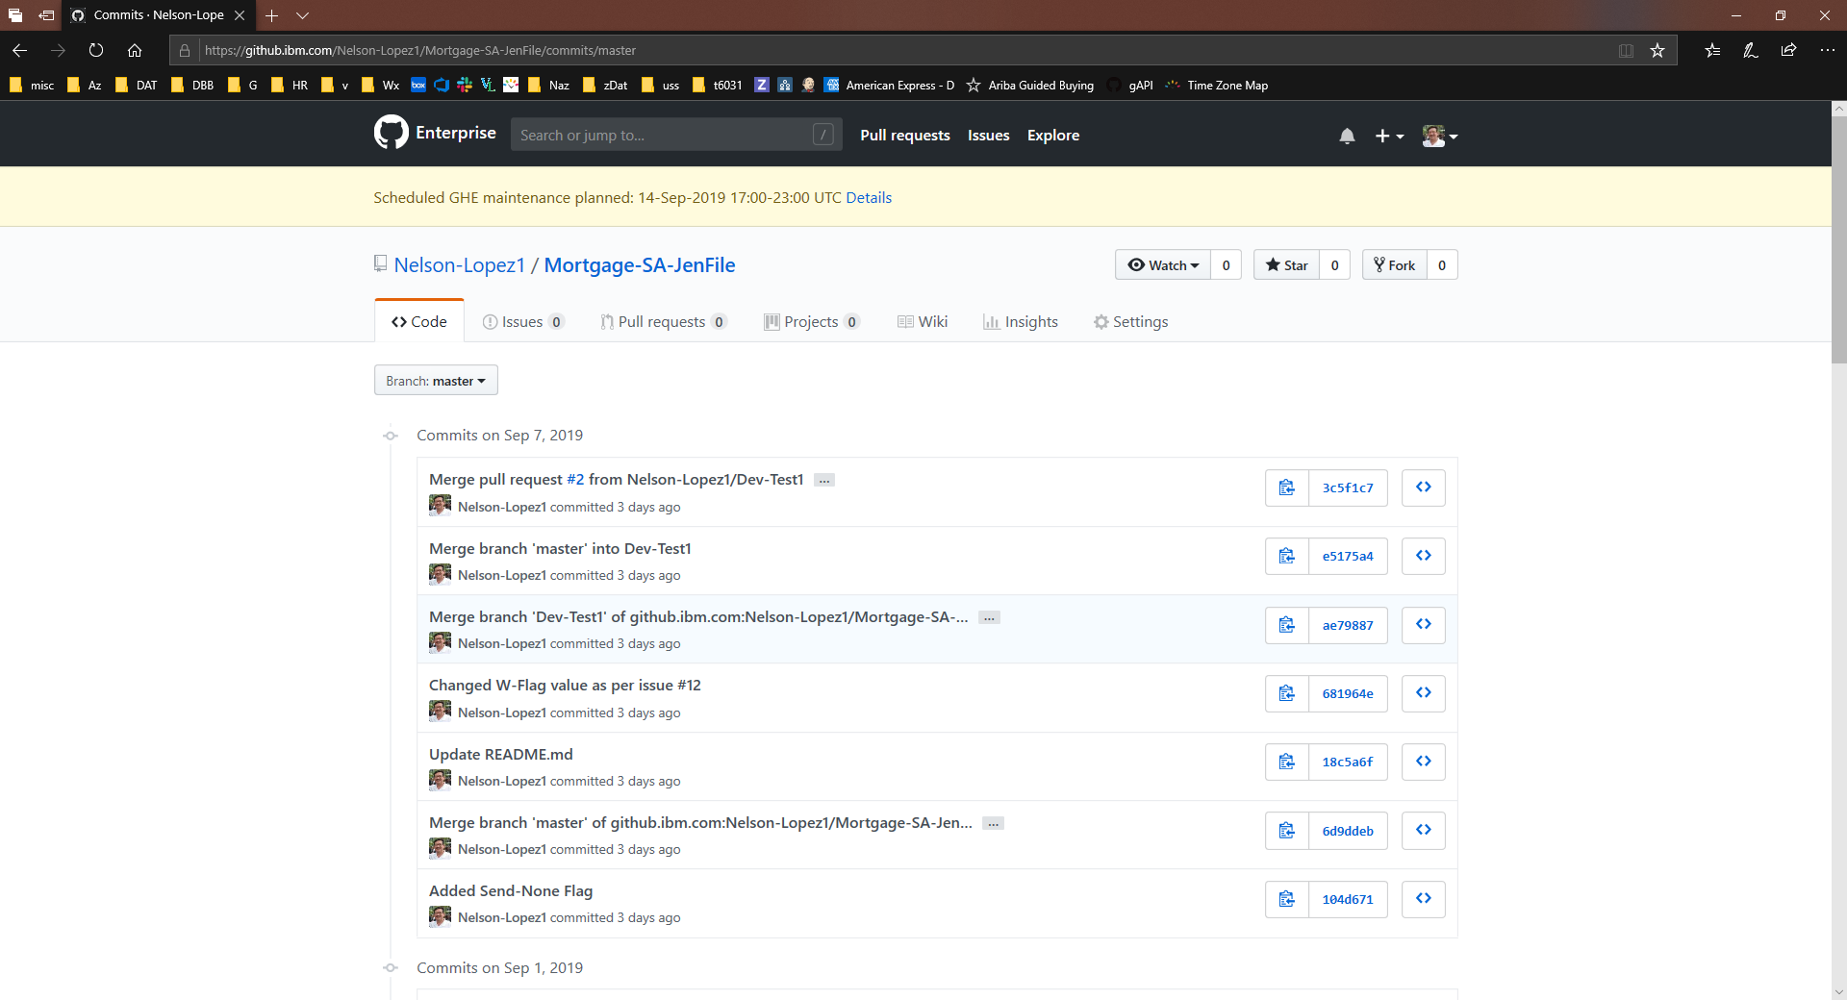
View the commit log
git log

Slide 10
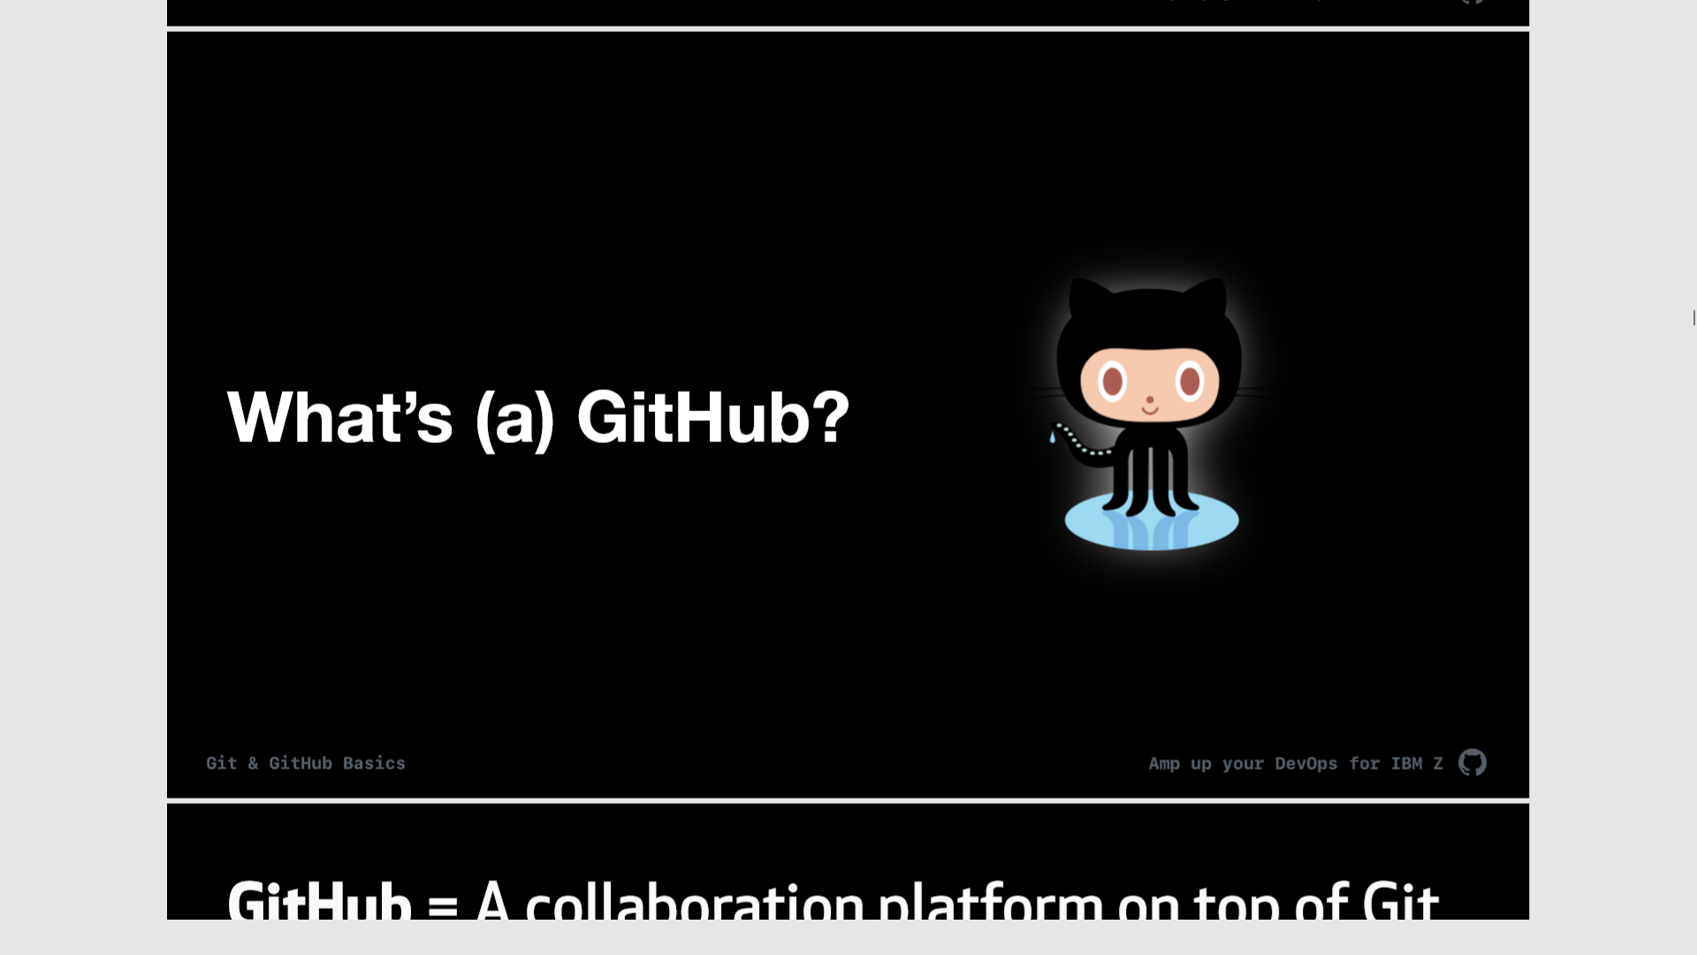

Slide 11
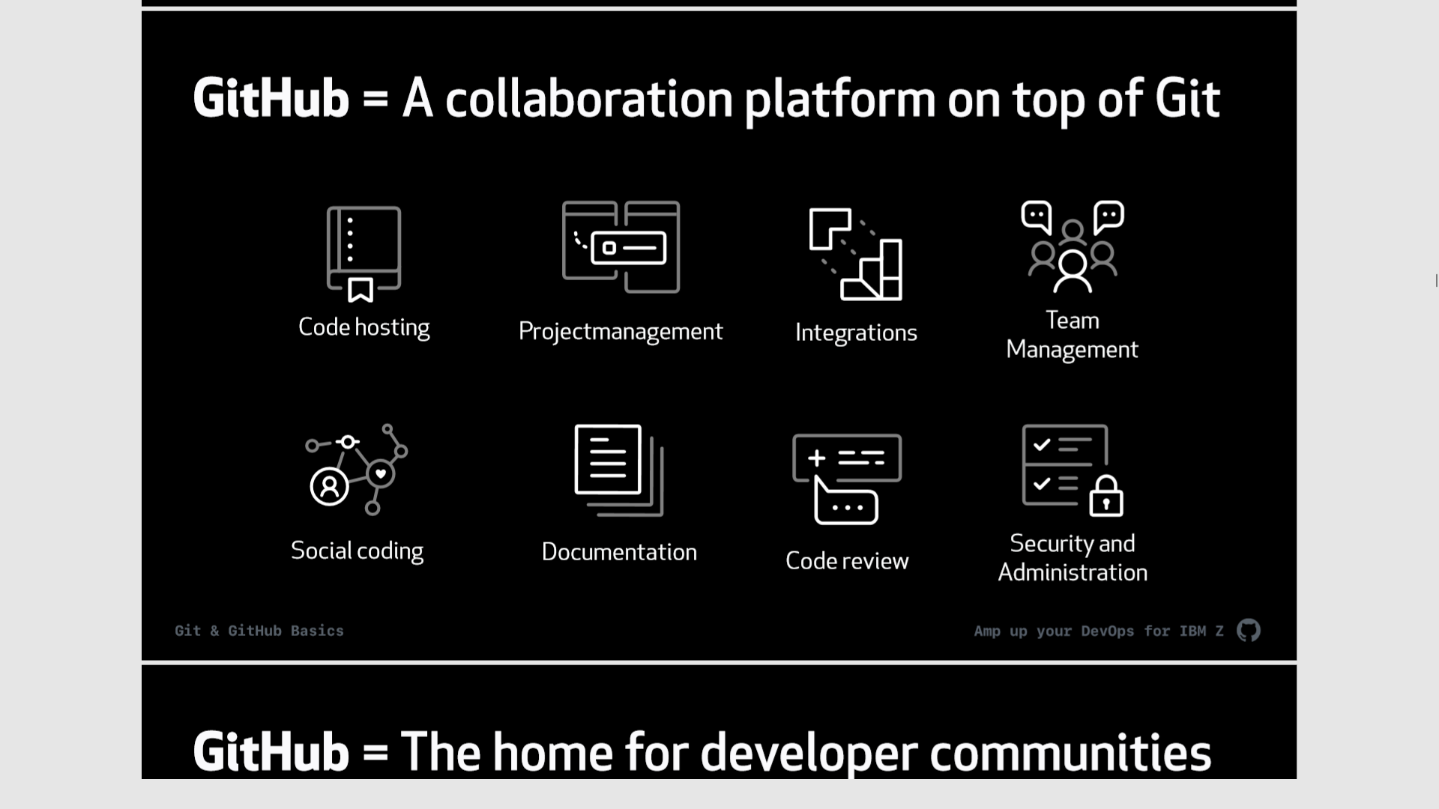

Slide 12
What is
IBM’s Dependency Based Build (DBB)?

Slide 13
DBB is used to build traditional z/OS applications without traditional skills and tools like JCL, ISPF, SDSF
It’s built as a stand-alone product that integrates with any modern IDE or SCM like Git
Enables automation through modern scripting languages like Groovy under any pipeline Orchestrator like Jenkins

Slide 14


DBB’s Intelligent Build
Dependencies between programs & copybooks are used to drive intelligent, efficient builds
Copybook1
PGM-A
Copybook2
PGM-B
Copybook3
PGM-C
Static Link

Slide 15

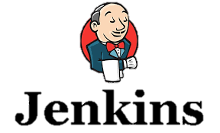




DBB Architecture (Continuous Integration Phase)
DBB WebApp
- Dependency Metadata
Build Results History
Start Job
Status, logs and links to reports
Logs
z/OS
Commit
DBB Toolkit
Any Git Server
Agent
MVS API’s
PDS
CLONE
Main Repository
CLONE to USS
Groovy Build scripts
Compile
&
link
Run Groovy build script
Return status and Logs
Scan, impact analysis, copy to PDS, compile, create artifacts, & report
USS
MVS

Slide 16
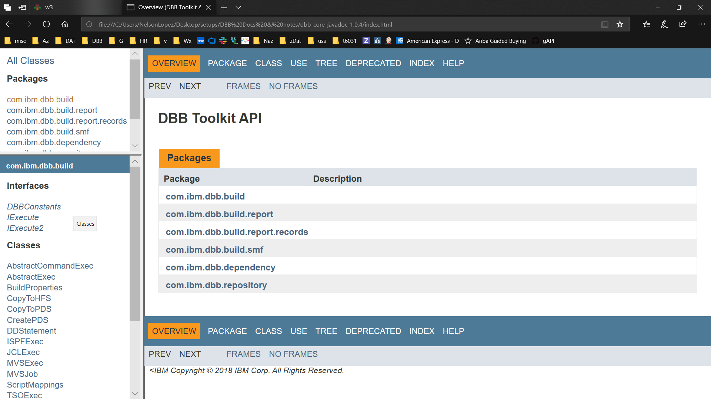
DBB Java API Toolkit
A set of Java APIs used to define scripts that:
Run MVS programs, TSO/ISPF commands, Submit JCL
Scan, store and retrieve application dependency metadata
Utilities to copy to/from PDS’s and USS zFS
Migrate source from PDS’s to Git

Slide 17
DBB Build Modes
Single Program - Build a single program in the application.
List of Programs - Build a list of programs provided by a text file.
Full Build - Build all programs (or buildable files) of an application.
Impact Build - Build only programs impacted changed since the last build.
Branch Build - Detects when building a topic branch for the first time and will automatically clone the dependency data collections from the main build branch in order to avoid having to rescan the entire application.
Scan Only - Skip the actual building and only scan source files for dependency data
¹

Slide 18
DBB Web Application
application dependency information
build reports
REST APIs access
DBB Sample Build Framework
free groovy scripts to build your own CI process
Visit and contribute to our public DBB repo
https://github.com/IBM/dbb

Slide 19
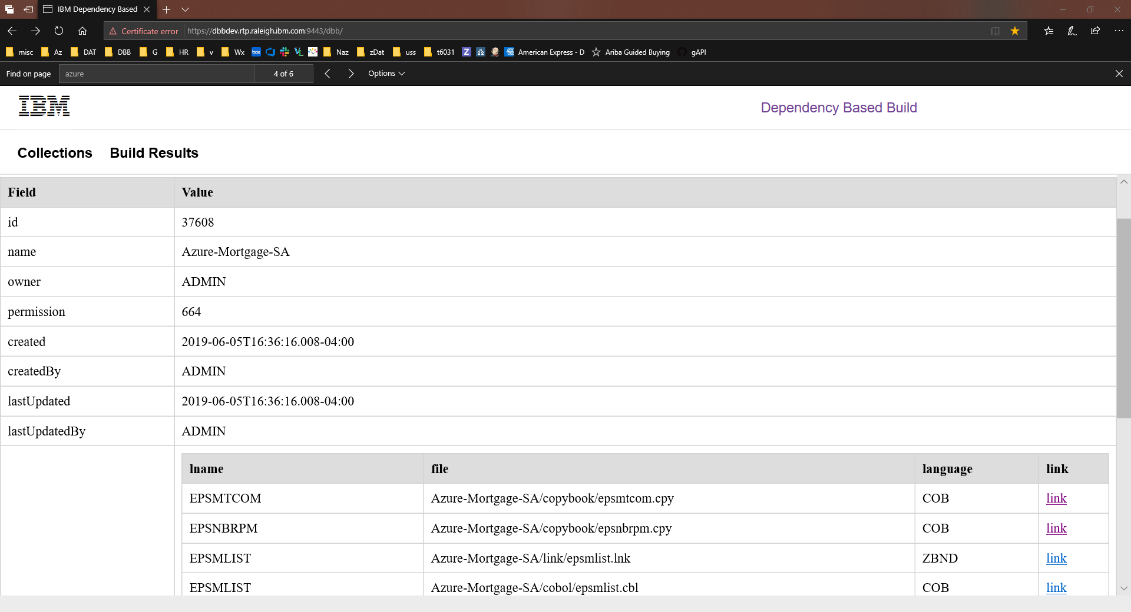

Slide 20
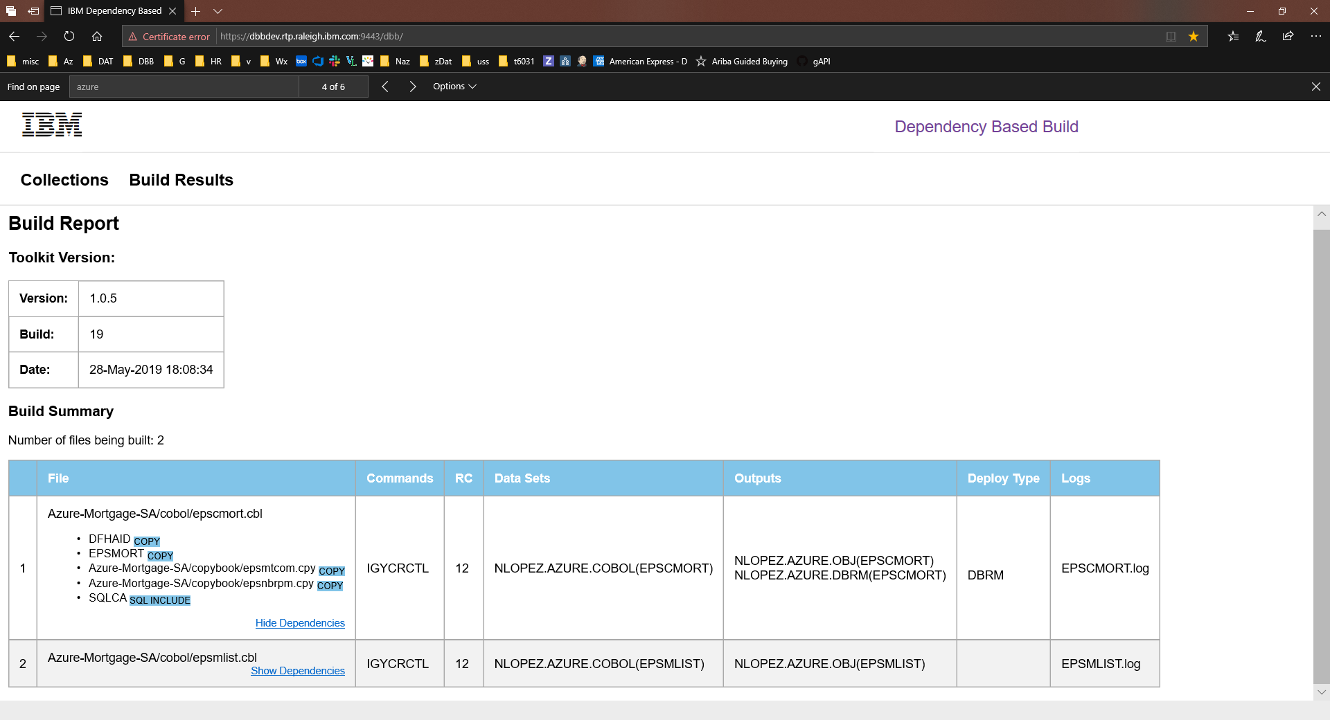

Slide 21
What is Groovy?

Slide 22
Groovy is a modern versatile scripting language widely used for DevOps automation
It integrates with Java programs or Toolkits like DBB
Concise, readable and expressive syntax and easy to learn
Jenkins uses Groovy for its native scripting support
DBB comes with a sample groovy framework called zAppBuild

Slide 23
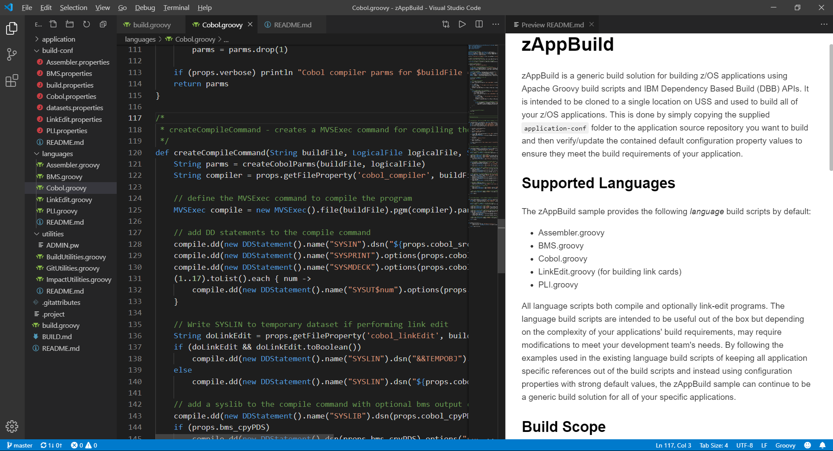
JCL vs Groovy+DBB APIs
import com.ibm.dbb.build.*
println("Copying source from zFS to PDS . . .")
def copy = new CopyToPDS().file(new File("/u/usr1/build/helloworld.cbl"))
.dataset("USR1.BUILD.COBOL").member("HELLO")
copy.execute()
println("Compiling . . .")
def tempOps = “tracks space(5,5) unit(vio) blksize(80) lrecl(80) recfm(f,b) new"
def compile = new MVSExec().pgm("IGYCRCTL").parm("LIB")
compile.dd(new DDStatement().name("TASKLIB").dsn("IGY.SIGYCOMP").options("shr"))
compile.dd(new DDStatement().name("SYSIN").dsn("USR1.BUILD.COBOL(HELLO)")
.options("shr"))
compile.dd(new DDStatement().name("SYSLIN").dsn("USR1.BUILD.OBJ(HELLO)")
.options("shr"))
compile.dd(new DDStatement().name("SYSPRINT").options(tempOps))
compile.dd(new DDStatement().name("SYSUT1").options(tempOps))
compile.dd(new DDStatement().name("SYSUT2").options(tempOps))
compile.dd(new DDStatement().name("SYSUT3").options(tempOps))
compile.dd(new DDStatement().name("SYSUT4").options(tempOps))
compile.dd(new DDStatement().name("SYSUT5").options(tempOps))
compile.dd(new DDStatement().name("SYSUT6").options(tempOps))
compile.dd(new DDStatement().name("SYSUT7").options(tempOps))
compile.copy(new CopyToHFS().ddName("SYSPRINT")
.file(new File("/u/usr1/build/helloworld.log")))
def rc = compile.execute()
if (rc > 4)
println("Compile failed! RC=$rc")
else
println("Compile successful! RC=$rc")
//COBOL EXEC PGM=IGYCRCTL,REGION=0M,
// PARM='LIB'
//*
//STEPLIB DD DISP=SHR,DSN=IGY.SIGYCOMP
//*
//SYSIN DD DISP=SHR,DSN=USER1.BUILD.COBOL(HELLO)
//SYSLIN DD DISP=SHR,DSN=USER1.BUILD.OBJ(HELLO)
//SYSPRINT DD SYSOUT=*
//SYSUT1 DD DISP=(NEW,PASS),SPACE=(TRK,(5,5)),UNIT=VIO,
// BLKSIZE=80,LRECL=80,RECFM=FB
//SYSUT2 DD DISP=(NEW,PASS),SPACE=(TRK,(5,5)),UNIT=VIO,
// BLKSIZE=80,LRECL=80,RECFM=FB
//SYSUT3 DD DISP=(NEW,PASS),SPACE=(TRK,(5,5)),UNIT=VIO,
// BLKSIZE=80,LRECL=80,RECFM=FB
//SYSUT4 DD DISP=(NEW,PASS),SPACE=(TRK,(5,5)),UNIT=VIO,
// BLKSIZE=80,LRECL=80,RECFM=FB
//SYSUT5 DD DISP=(NEW,PASS),SPACE=(TRK,(5,5)),UNIT=VIO,
// BLKSIZE=80,LRECL=80,RECFM=FB
//SYSUT6 DD DISP=(NEW,PASS),SPACE=(TRK,(5,5)),UNIT=VIO,
// BLKSIZE=80,LRECL=80,RECFM=FB
//SYSUT7 DD DISP=(NEW,PASS),SPACE=(TRK,(5,5)),UNIT=VIO,
// BLKSIZE=80,LRECL=80,RECFM=FB

Slide 24
Your Cobol code on Git & DBB

Slide 25
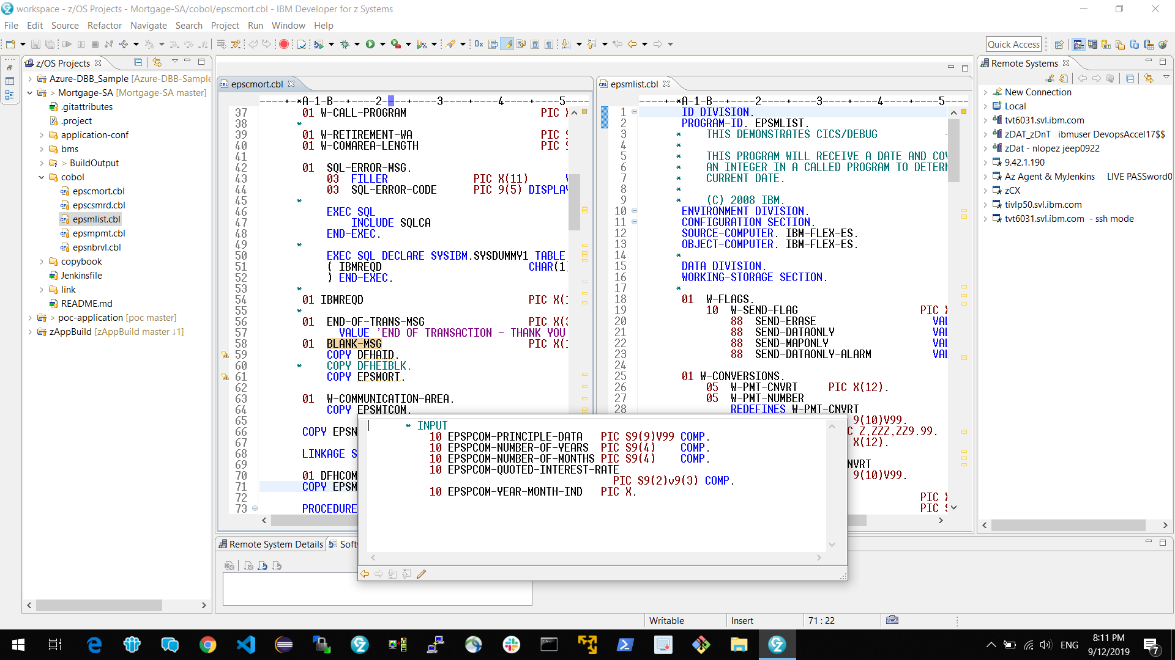
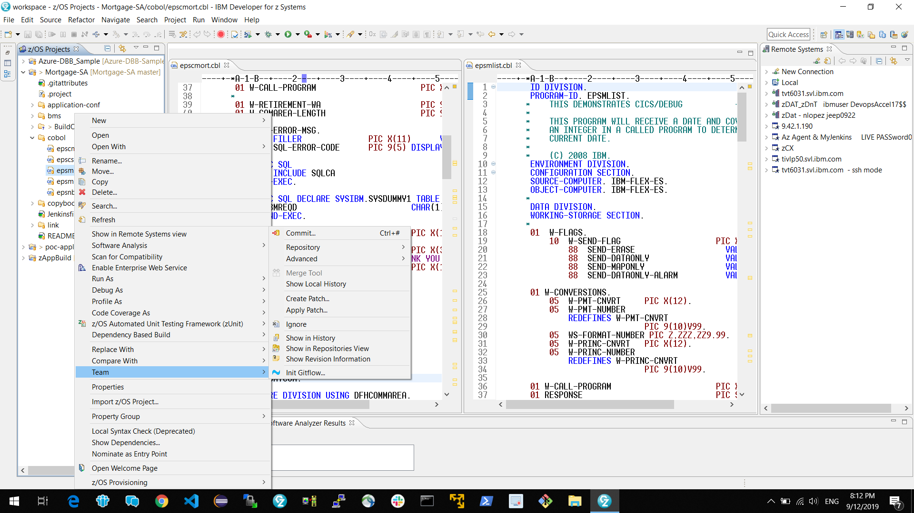
Dev Lifecycle with a Modern IDE (IDz)
Clone
Branch
Update code
DBB User Build
Unit test
Pull Request

Slide 26
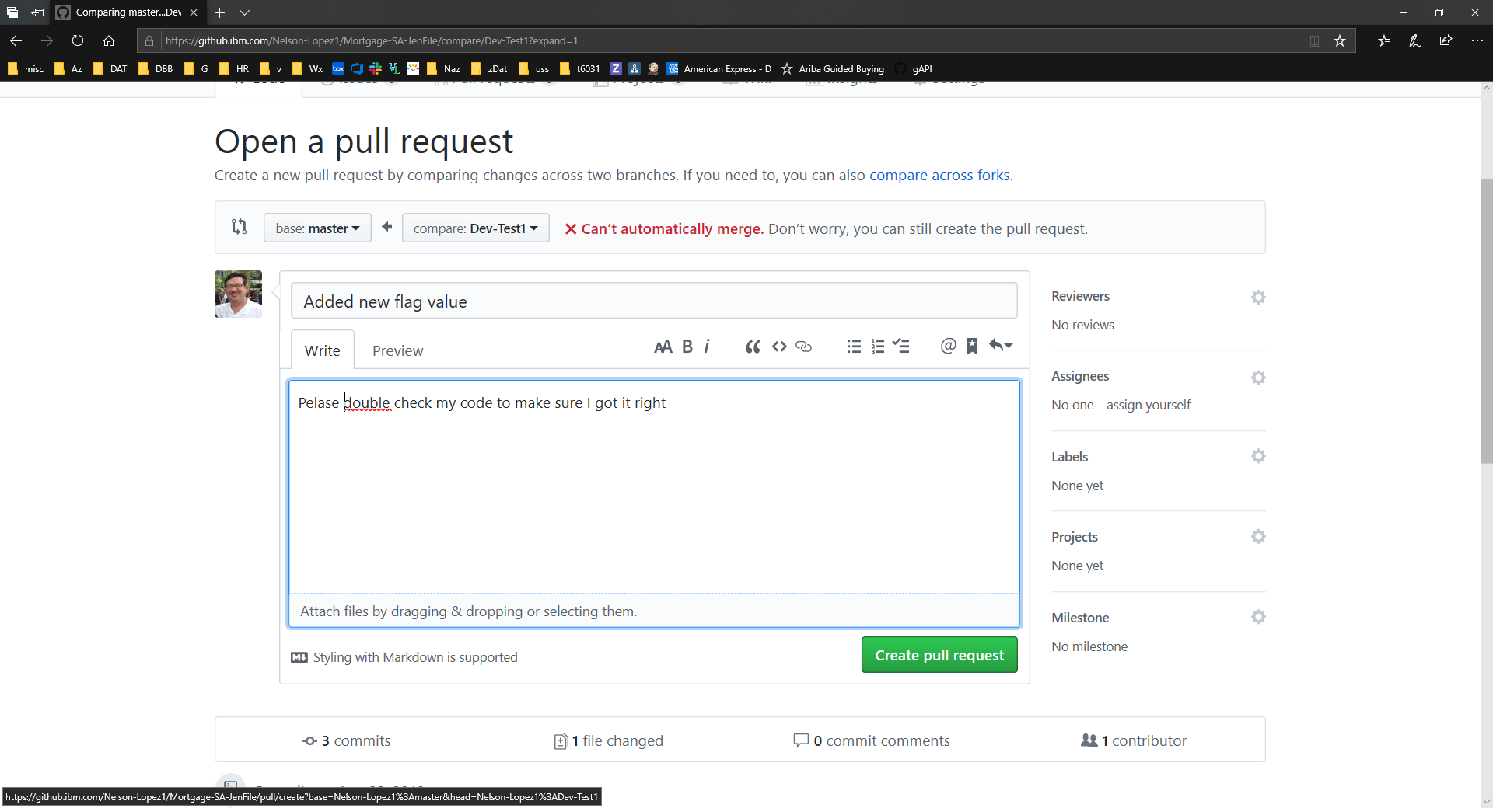
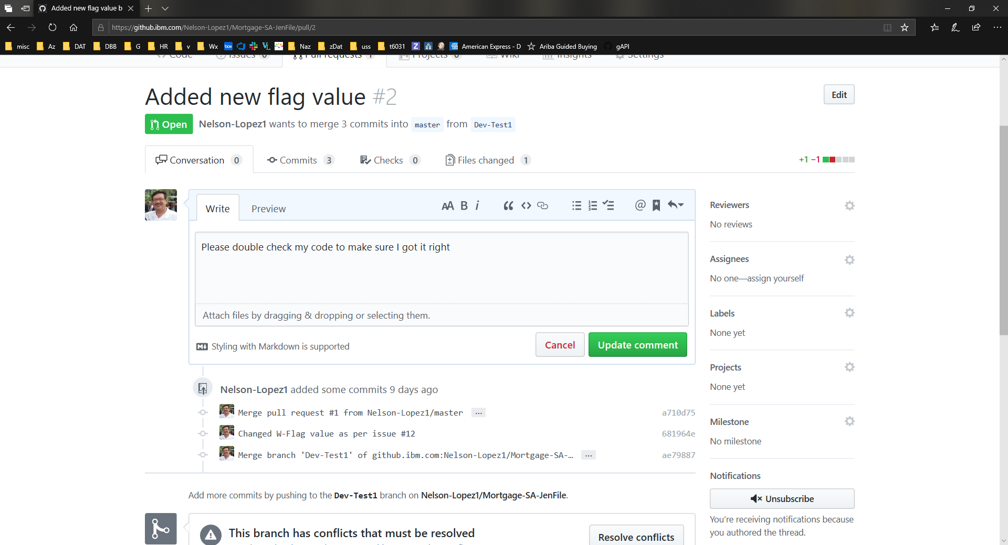
Document the change
&
Create a Pull Request (PR)

Slide 27

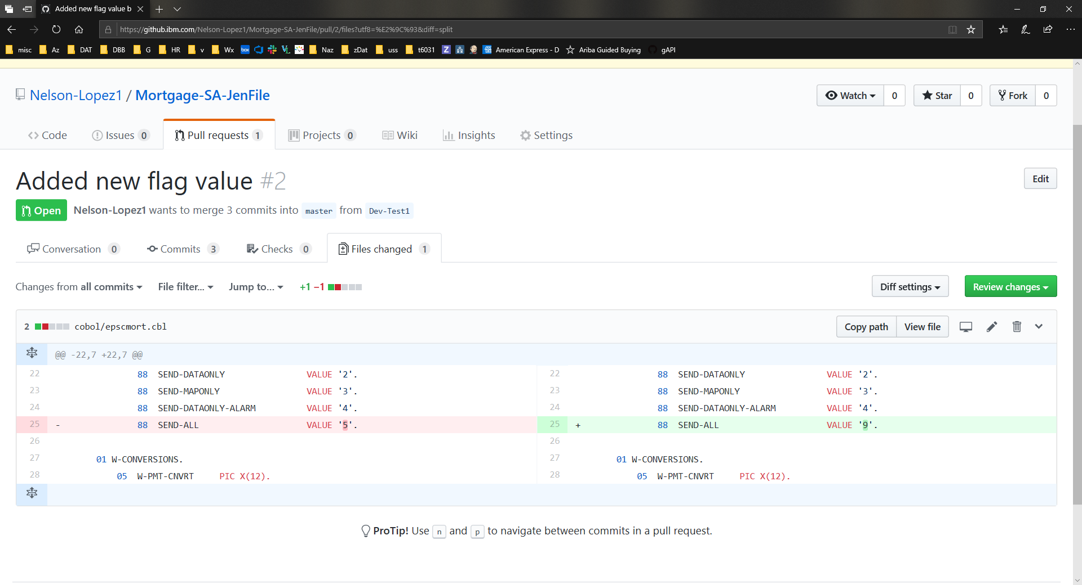
Peer Code Review
Diff old vs new

Slide 28
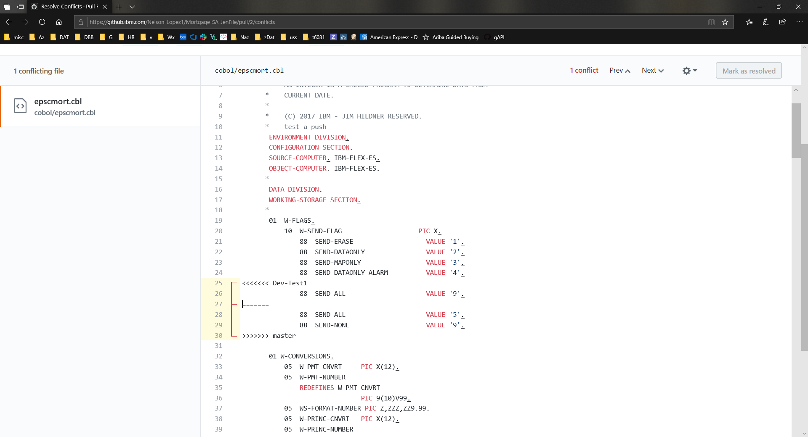
Opps … catching merge conflicts

Slide 29
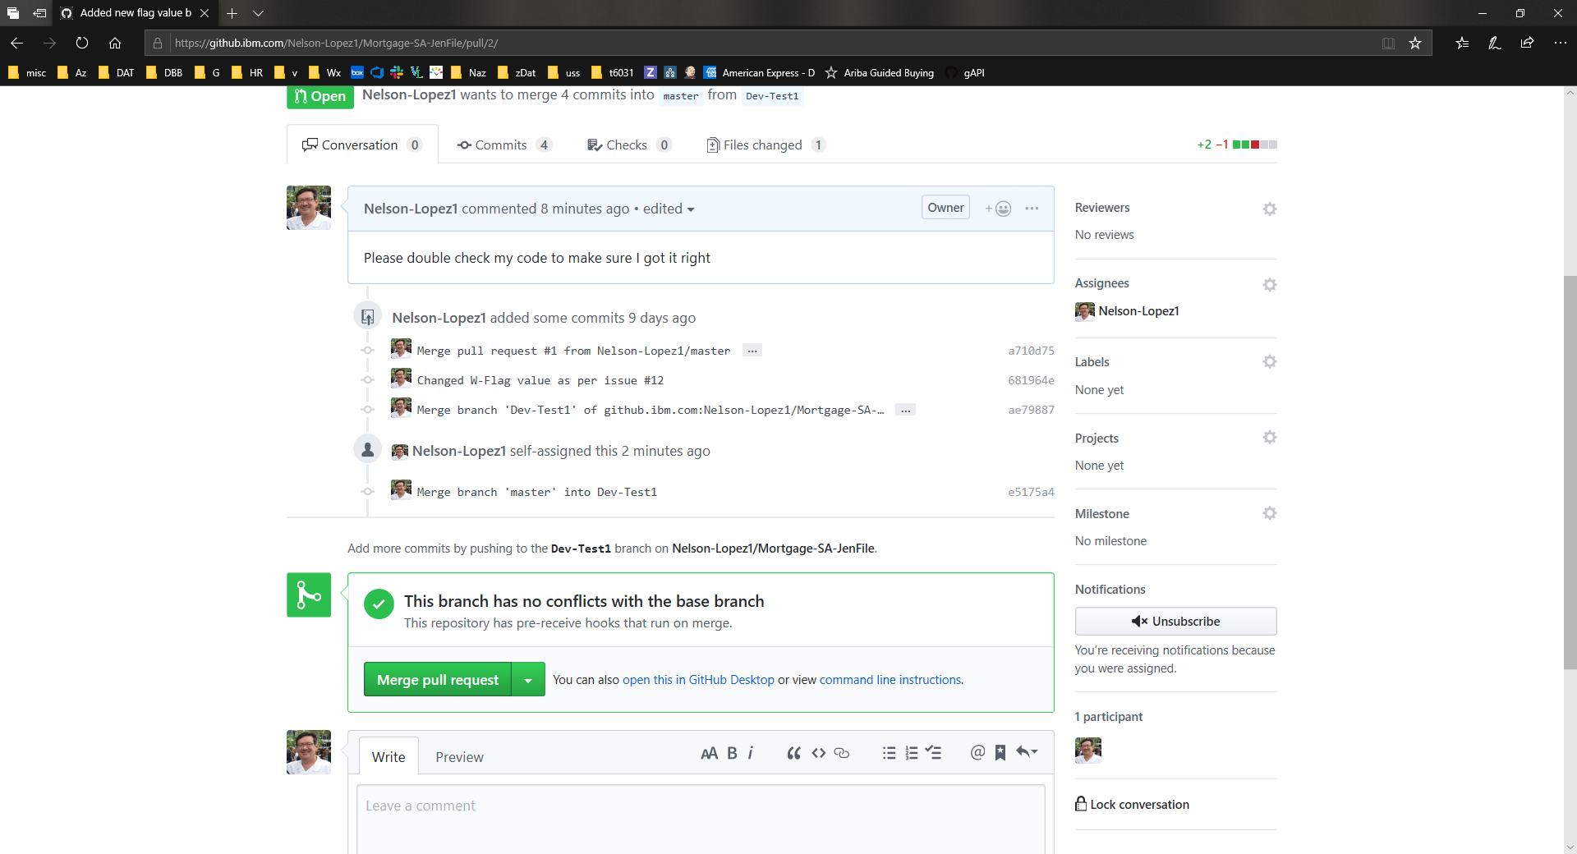
Merge the PR
to auto
trigger a pipeline
Build

Slide 30
Deployment

Slide 31
Notes:
What we want to do is provide this pipeline as the automation framework for the DevOps transformation

Slide 32
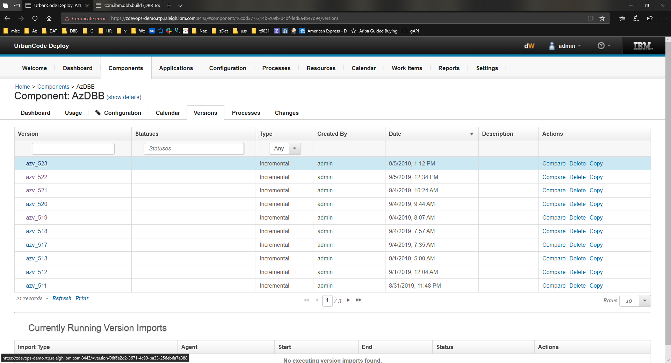
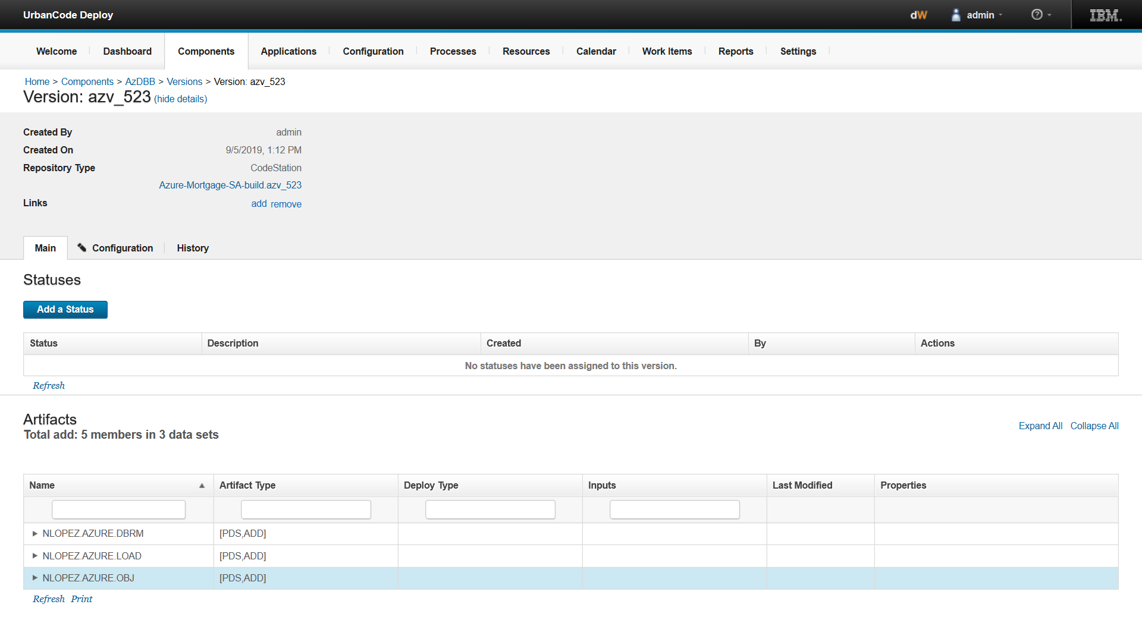
Urban Code Deploy
Artifact Store
Artifact Store
Link to trace back to DBB Build Report for this release

Slide 33
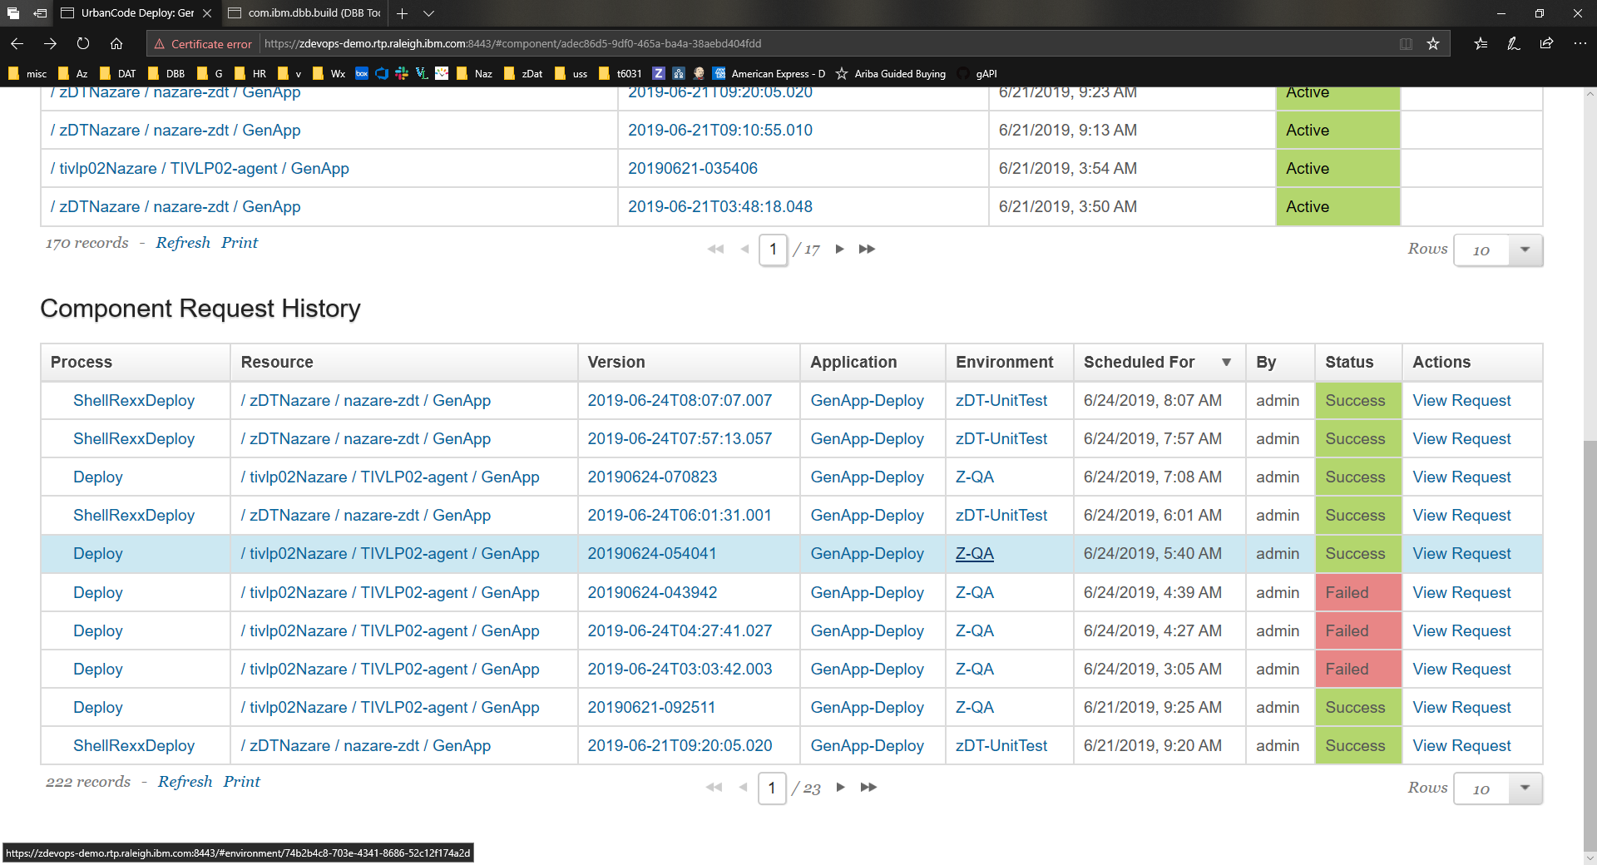
Dashboard to see where your
code has been deployed
Deployment

Slide 34
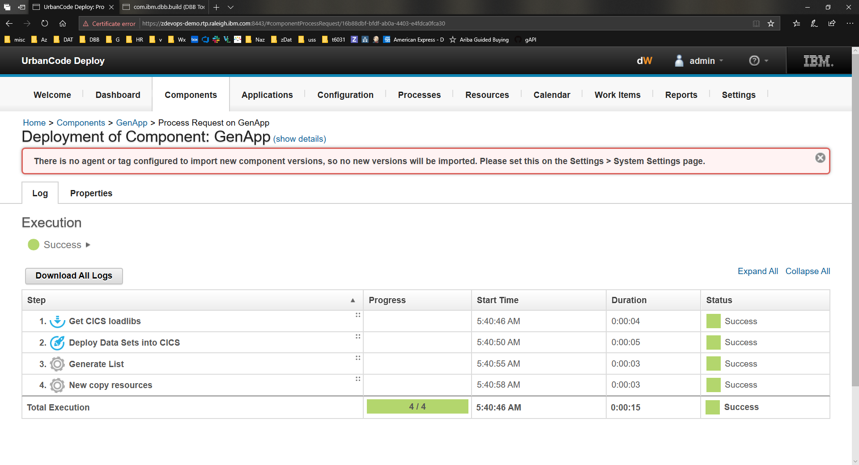
Deployment details
Deployment

Slide 35
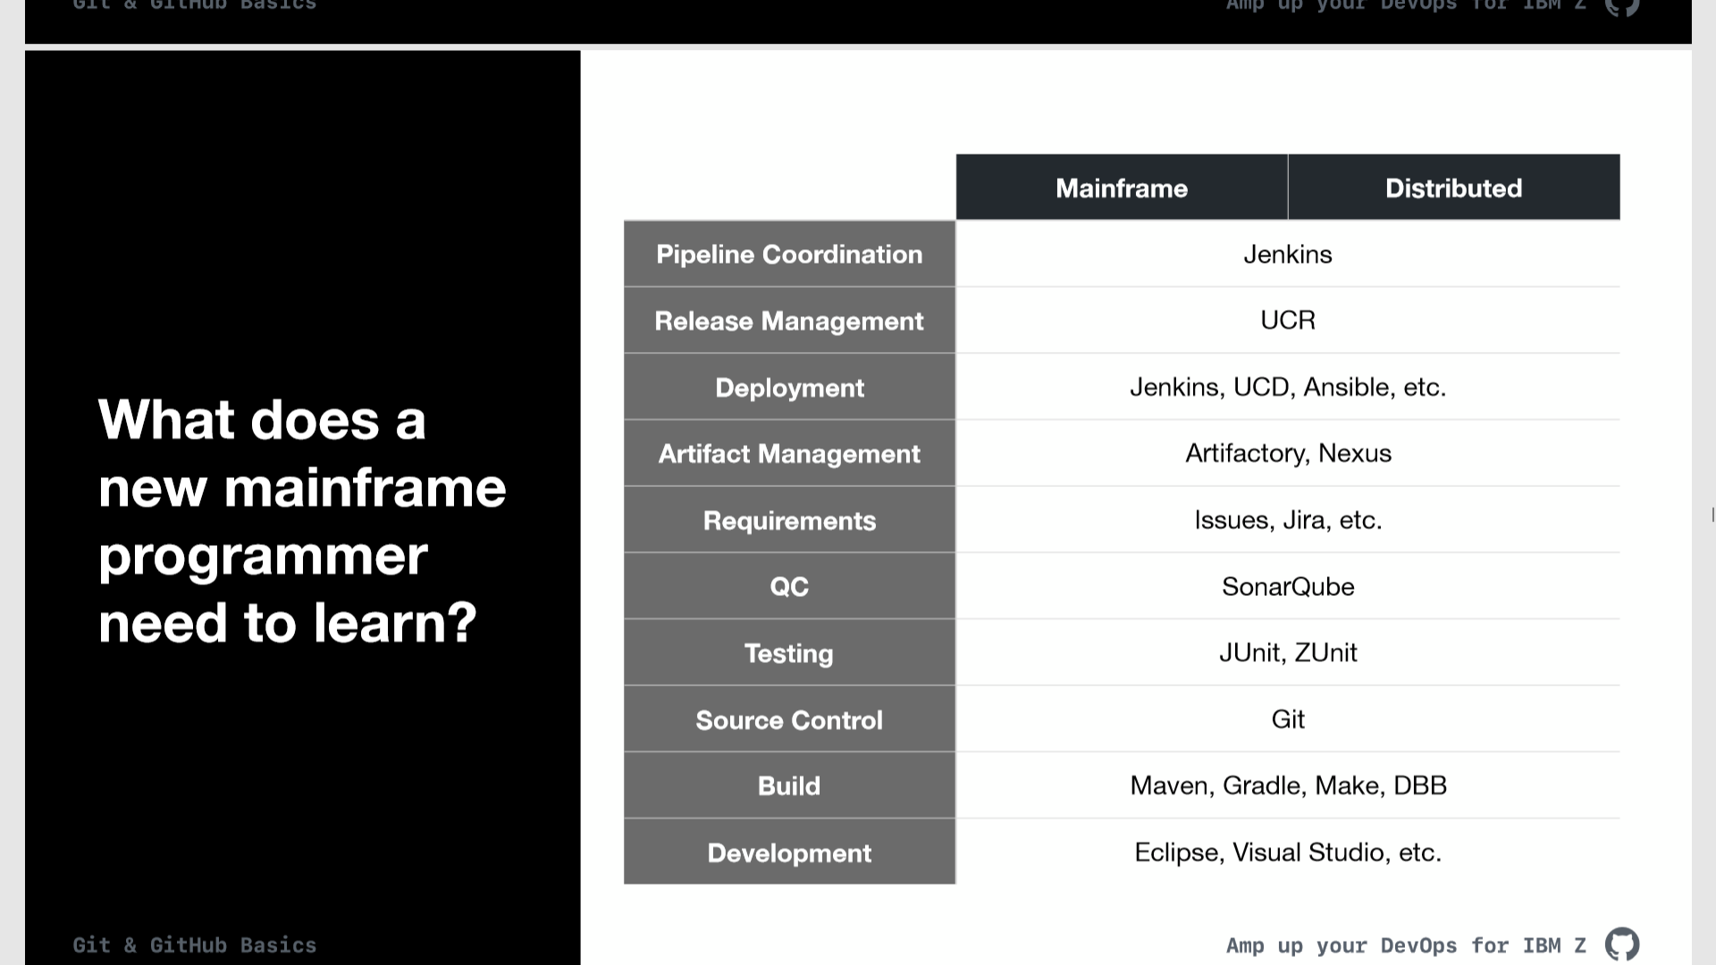
Mainframe | Distributed
Distributed
A common toolchain for all

Slide 36
DEMO

Slide 37
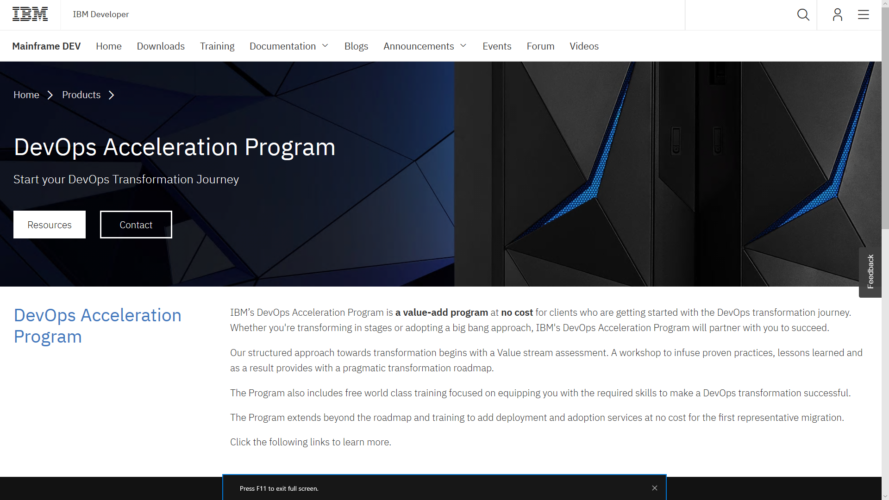
How to get started on your Z DevOps journey
https://developer.ibm.com/mainframe/products/devops-acceleration-program/

Slide 38
DevOps transformation journey with IBM’s DevOps Acceleration Program
Train
Discovery & Design
Remote or Onsite discovery and design workshop
Identify current state setup
Determine future state architecture
Deployment
Migration
Any SCM to DBB-Git
Complete assistance from creating your implementation plan, scripts etc.
Know our DevOps strategy and Products
Install and customize products
Train
Discovery & Design
Innovate
Migration
Migrate
Deployment
Lift & shift applications and workloads
SCM Migration – Onsite and remote support
ILT Virtual or Self paced trainings
Build new
cloud native applications
Remote assistance
Remote or onsite workshop

Slide 39





IBM DevOps Acceleration Program - Migration planning, tools and services
Analysis Tools
Questionnaire
Extraction Tools
BP/Client Tools
Scanner Tools
Application Discovery (ADDI)
Migration Tools
CI/CD
CI/CD
Pipeline
SCLM
JCL
Source Code
Analyse
Extract
Componentize
CI/CD
Migrate
Analyse the development process, infrastructure and document the current state
Extract Metadata, Source Libraries, Compile Procedures and options, Languages, File types from Host SCM
Identify Interfaces and dependencies between applications and boundaries
Derive future state architecture
Establish CI/CD workflow
Product deployment
Setup repos and Import
Setup the scripts and establish the pipeline

Slide 40
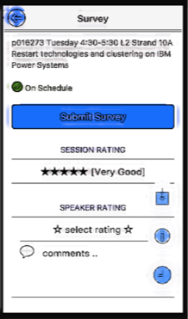
Thank you!
Nelson Lopez
IBM Z DevOps Specialist
RTP Lab at North Carolina
Nelson.lopez1@ibm.com
Please complete the Session
Evaluation!

Slide 41
Notices and disclaimers
© 2019 International Business Machines Corporation. No part of this document may be reproduced or transmitted in any form without written permission from IBM.
U.S. Government Users Restricted Rights — use, duplication or disclosure restricted by GSA ADP Schedule Contract with IBM.
Information in these presentations (including information relating to products that have not yet been announced by IBM) has been reviewed for accuracy as of the date of initial publication and could include unintentional technical or typographical errors. IBM shall have no responsibility to update this information. This document is distributed “as is” without any warranty, either express or implied. In no event, shall IBM be liable for any damage arising from the use of this information, including but not limited to, loss of data, business interruption, loss of profit or loss of opportunity. IBM products and services are warranted per the terms and conditions of the agreements under which they are provided.
IBM products are manufactured from new parts or new and used parts. In some cases, a product may not be new and may have been previously installed. Regardless, our warranty terms apply.”
Any statements regarding IBM's future direction, intent or product plans are subject to change or withdrawal without notice.
Performance data contained herein was generally obtained in a controlled, isolated environments. Customer examples are presented as illustrations of how those
customers have used IBM products and the results they may have achieved. Actual performance, cost, savings or other results in other operating environments may vary.
References in this document to IBM products, programs, or services does not imply that IBM intends to make such products, programs or services available in all countries in which IBM operates or does business.
Workshops, sessions and associated materials may have been prepared by independent session speakers, and do not necessarily reflect the views of IBM. All materials and discussions are provided for informational purposes only, and are neither intended to, nor shall constitute legal or other guidance or advice to any individual participant or their specific situation.
It is the customer’s responsibility to insure its own compliance with legal requirements and to obtain advice of competent legal counsel as to the identification and interpretation of any relevant laws and regulatory requirements that may affect the customer’s business and any actions the customer may need to take to comply with such laws. IBM does not provide legal advice or represent or warrant that its services or products will ensure that the customer follows any law.

Slide 42
Notices and disclaimers continued
Information concerning non-IBM products was obtained from the suppliers of those products, their published announcements or other publicly available sources. IBM has not tested those products about this publication and cannot confirm the accuracy of performance, compatibility or any other claims related to non-IBM products. Questions on the capabilities of non-IBM products should be addressed to the suppliers of those products. IBM does not warrant the quality of any third-party products, or the ability of any such third-party products to interoperate with IBM’s products. IBM expressly disclaims all warranties, expressed or implied, including but not limited to, the implied warranties of merchantability and fitness for a purpose.
The provision of the information contained herein is not intended to, and does not, grant any right or license under any IBM patents, copyrights, trademarks or other intellectual property right.
IBM, the IBM logo, ibm.com and [names of other referenced IBM products and services used in the presentation] are trademarks of International Business Machines Corporation, registered in many jurisdictions worldwide. Other product and service names might be trademarks of IBM or other companies. A current list of IBM trademarks is available on the Web at "Copyright and trademark information" at: www.ibm.com/legal/copytrade.shtml

